Slide 1

A quick flight to the edge of Data Science
Eric Wanjau
Gold MLSA Researcher/Data Scientist LIDA
Modeling and Machine Learning with Tidymodels

Slide 2
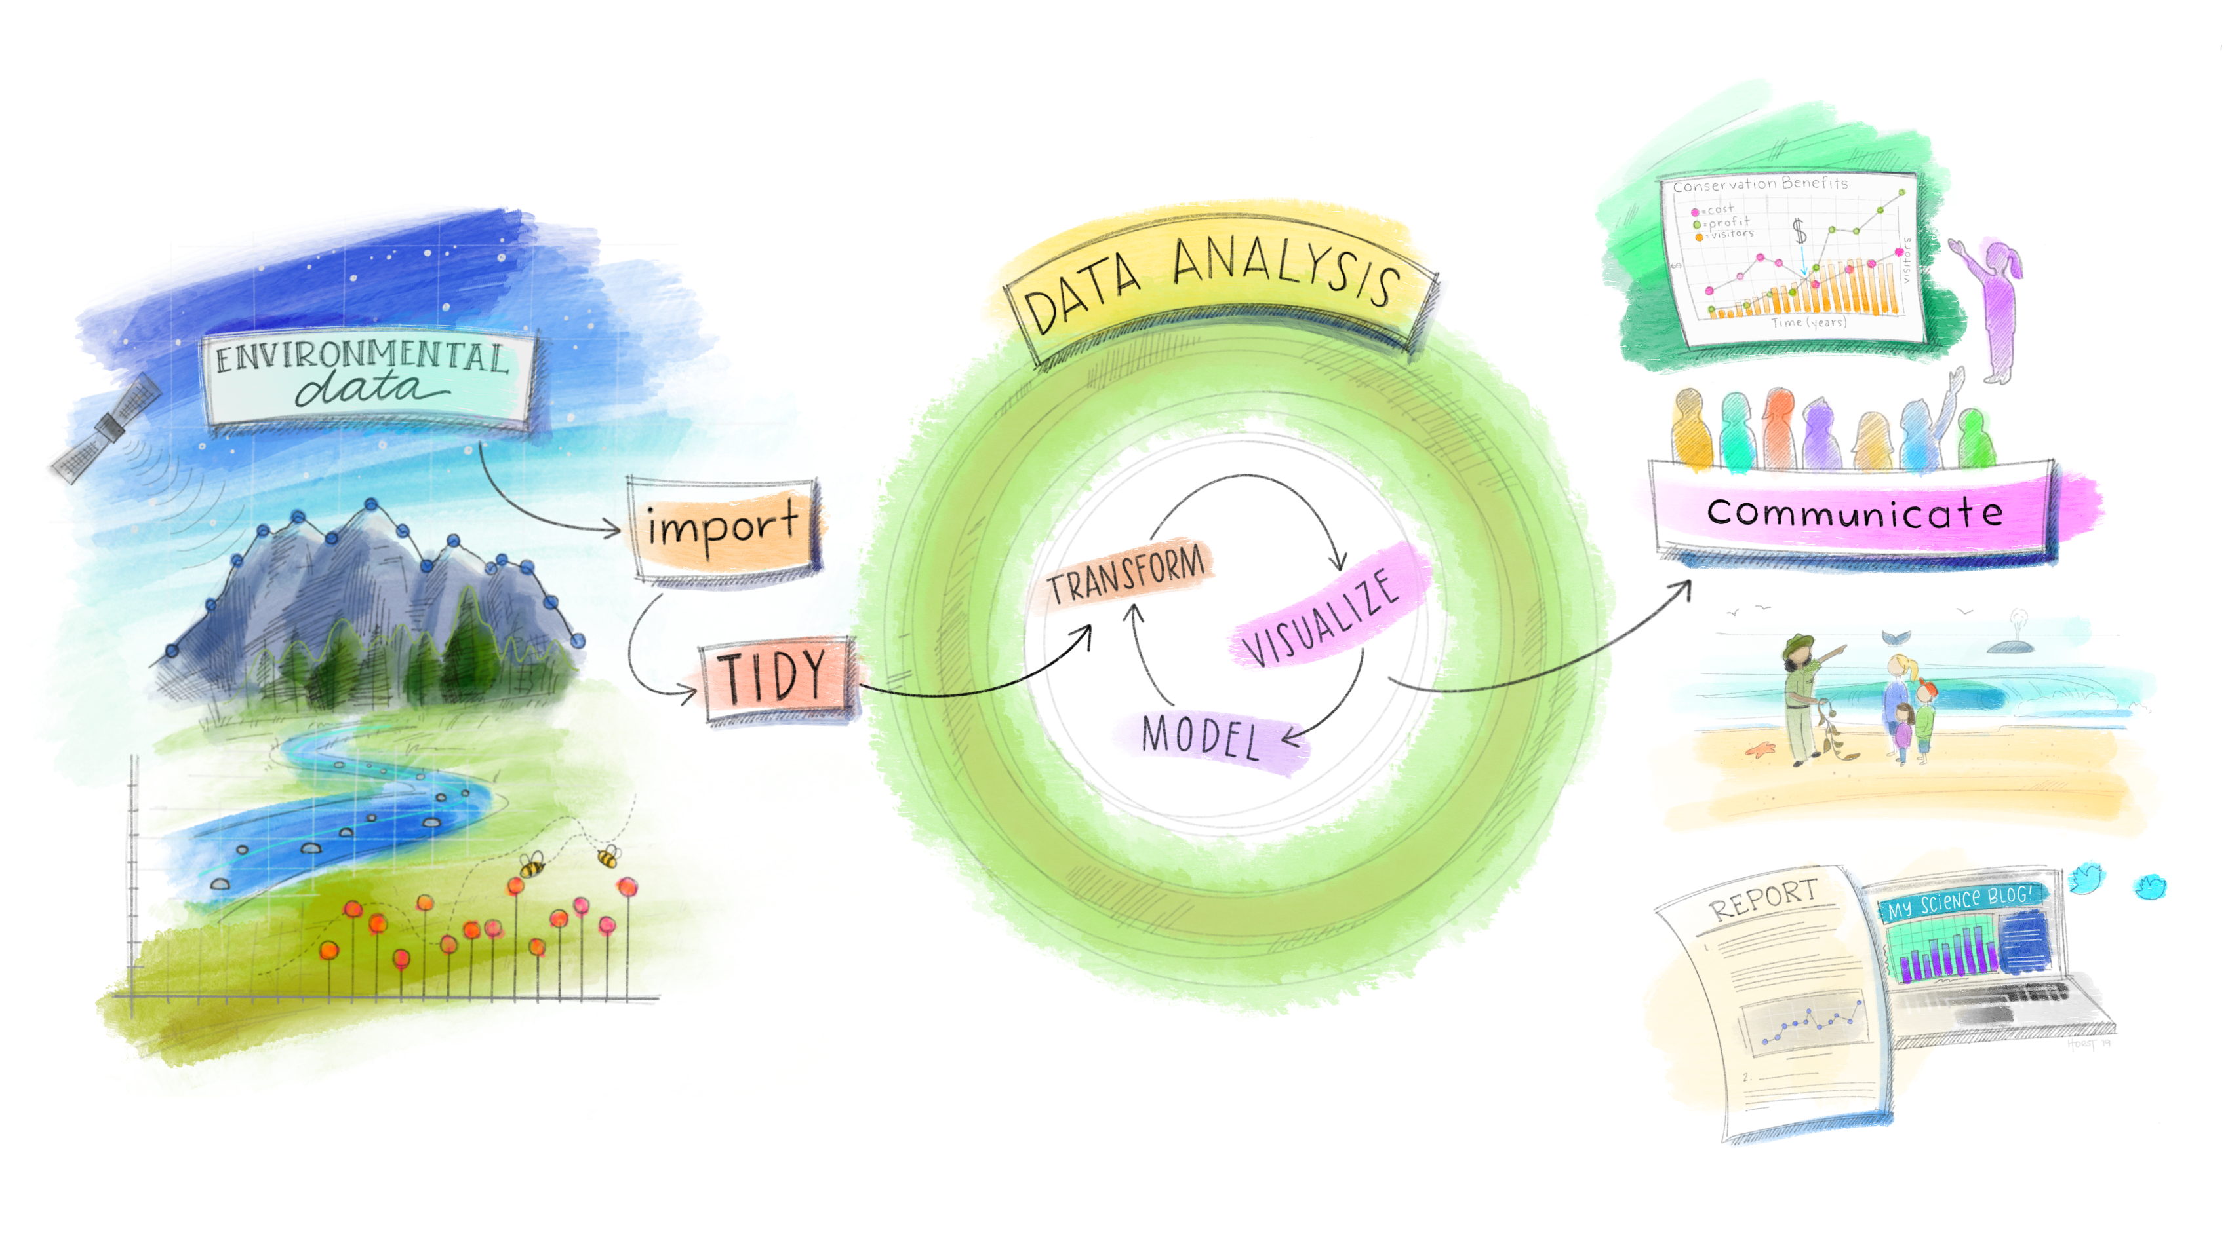
How does modelling fit into the Data Analysis process

Slide 3
There are always a few critical phases of data analysis that come before modeling.​

Slide 4

The modeling process
Many books/courses often portray predictive modeling as a one-time easy peasy process.
A better analogy would be to view it as an iterative process involving a number of steps and decisions to make.

Slide 5
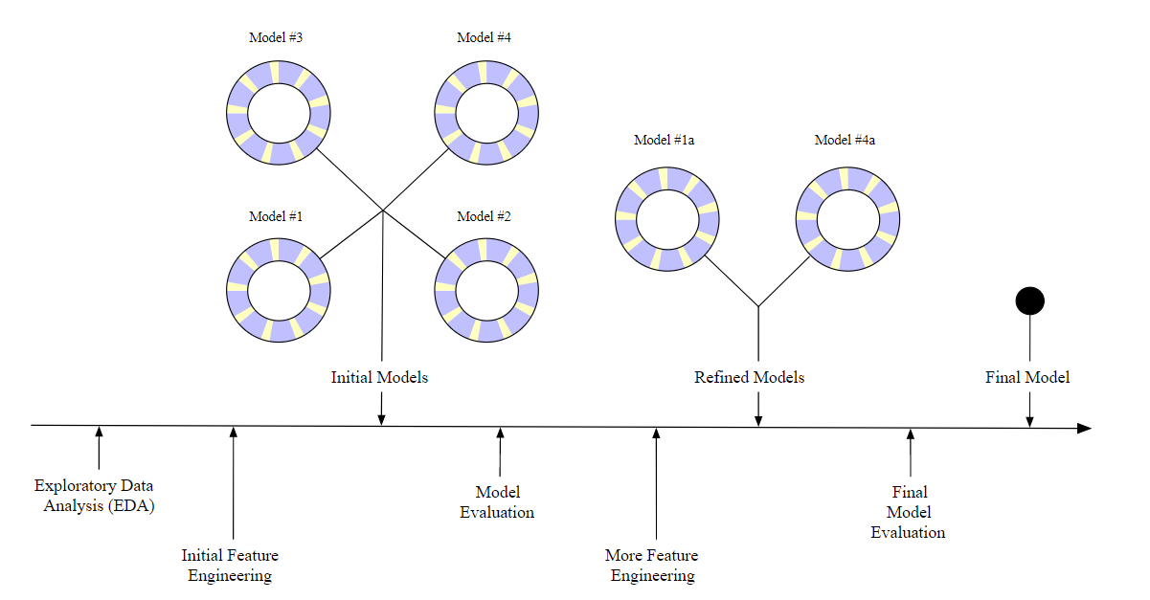
The modeling process
Exploratory data analysis (EDA)
Feature engineering
Model tuning and selection (large circles with alternating segments)
Moving on to the final model

Slide 6

There are many modeling packages in R and then there is
Modeling framework that allows you to build upon existing R packages

Slide 7
Why Tidymodels?

Slide 8
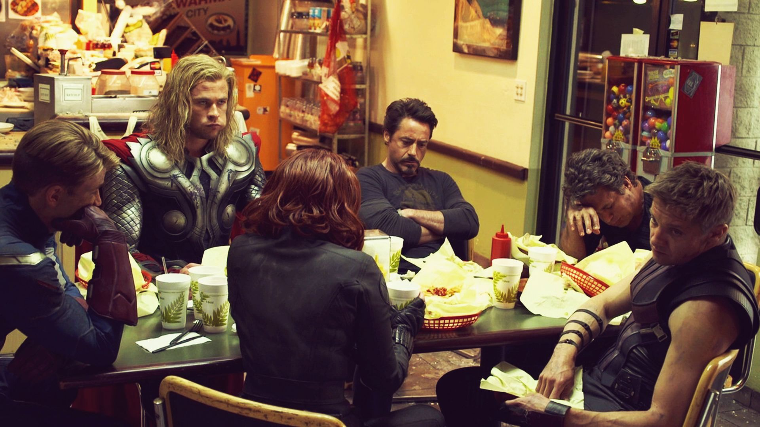
1. We are all on the same team
unified interface to underlying packages that do the same thing

Slide 9
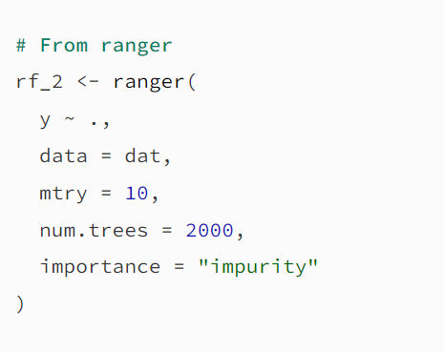
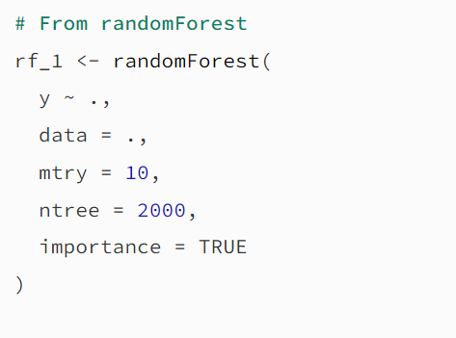
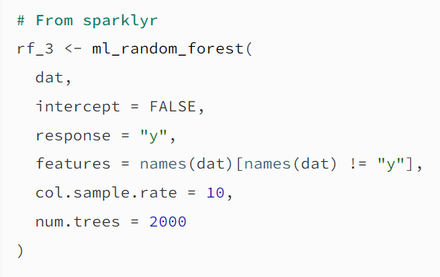
# Model spec in tidymodels
rf <- rand_forest(mtry = 10, trees = 2000) %>%
set_mode(“regression”) %>%
set_engine(“_ _ _ _ _ _”)
Notes:
the model syntax can be very different and that the argument names (and formats) are also different. This is a pain if you switch between implementations.

Slide 10
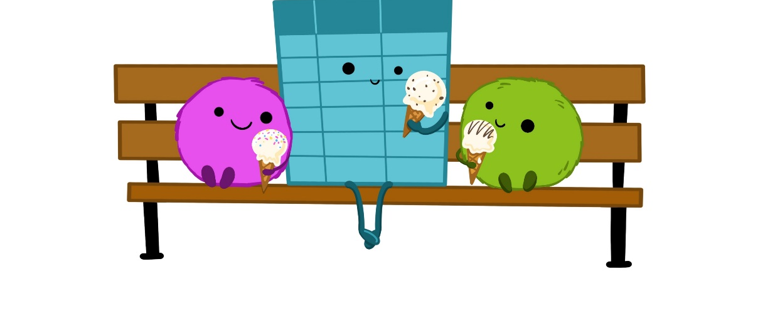
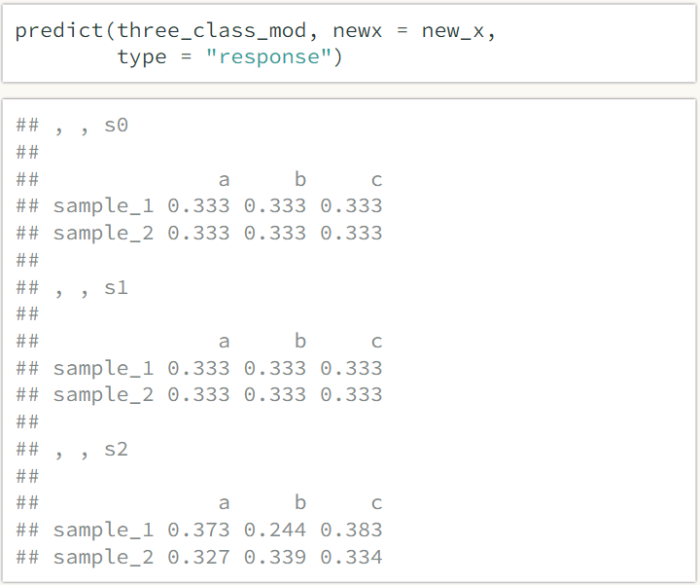
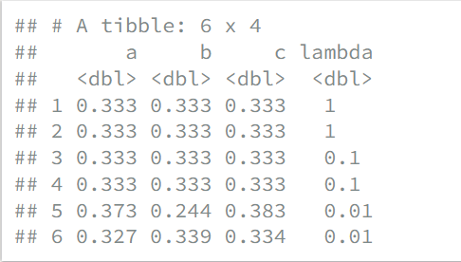
2. Returns our good old tibbles

Slide 11
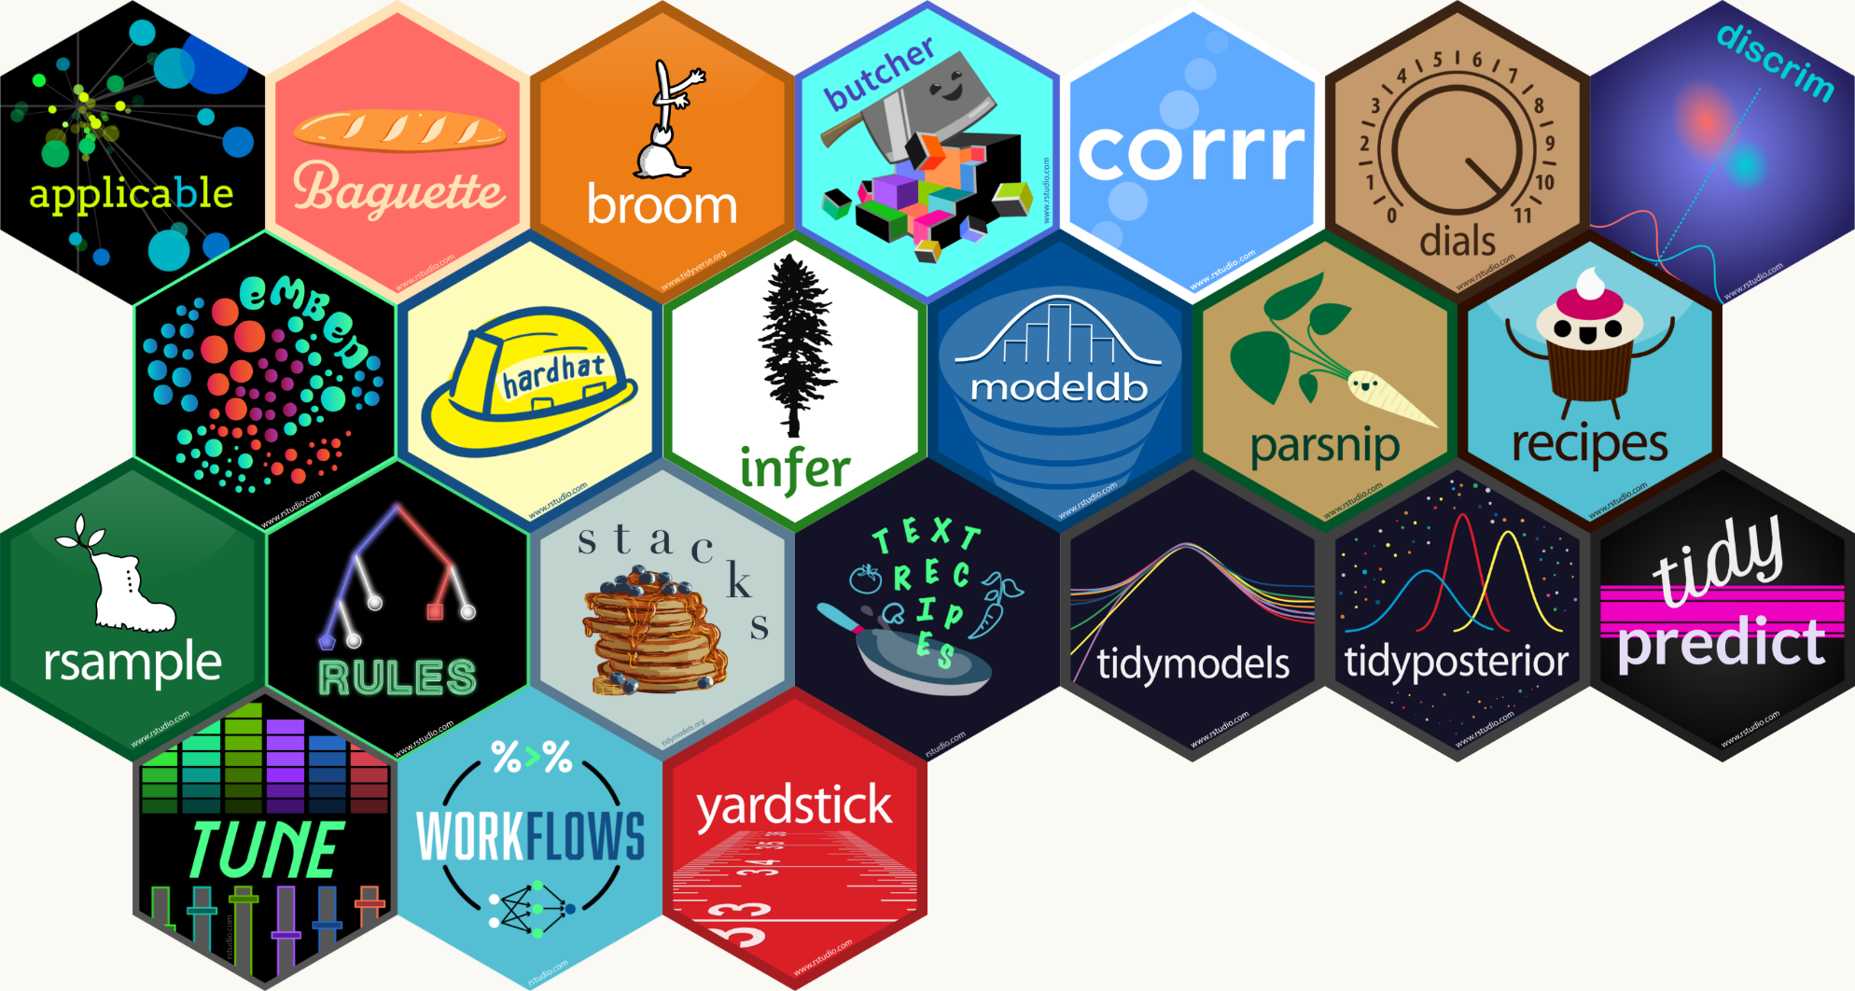
3. Additional tools for creating effective and high-quality models
Splitting data
Feature Engineering
Model performance
Notes:
support good scientific methodology and ease of use for practitioners from diverse backgrounds

Slide 12
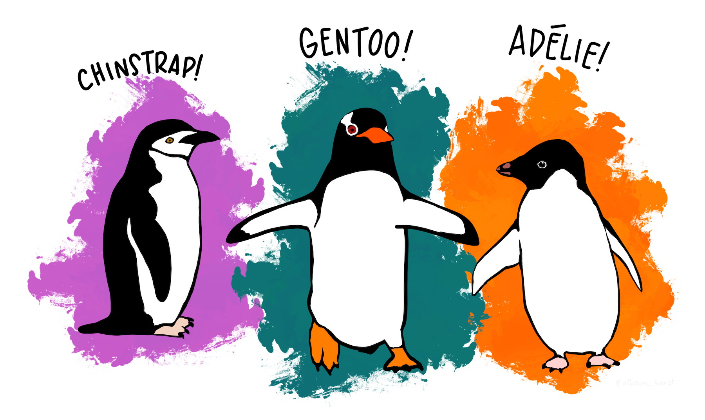
Classifying penguins.
Build and fit a random forest model
Use the model to classify
Try out a different engine

Slide 13
Knowledge Check
You plan to use the Tidymodels framework to train a model. What information would you need to make a model specification? (there are multiple answers)
A. Model Engine
B. Model Mode
C. Model Recipe
D. Model Type

Slide 14
Knowledge Check
You plan to use the Tidymodels framework to train a model. What information would you need to make a model specification?
A. Model Engine: is the R package which will be used to fit the model
B. Model Mode: includes common options like regression and classification
C. Model Recipe: A recipe is an object that defines a series of steps for data processing.
D. Model Type: differentiates models such as logistic regression, decision tree models

Slide 15

Q. What’s a penguin’s favorite movie?
Frozen

Slide 16
Recap & Further Reading
What is the Tidymodels framework?
How Tidymodels eases modeling for practitioners from diverse backgrounds.
Building models using Tidymodels framework.
Max Kuhn and Julia Silge, Tidy Modeling with R.
Max Kuhn talk – Cleveland RUG
Tidymodels reference website.
Bradley Boehmke & Brandon Greenwell, Hands-On Machine Learning with R.
H. Wickham and G. Grolemund, R for Data Science: Visualize, Model, Transform, Tidy, and Import Data.

